Slide 1
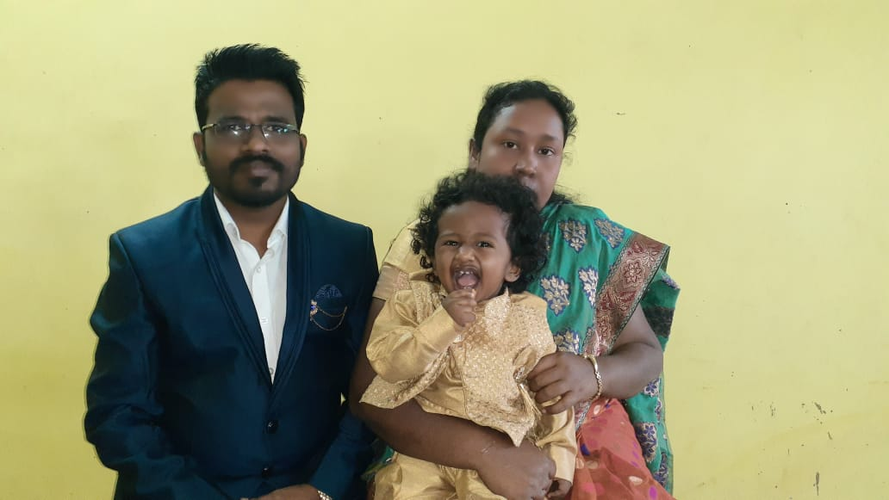
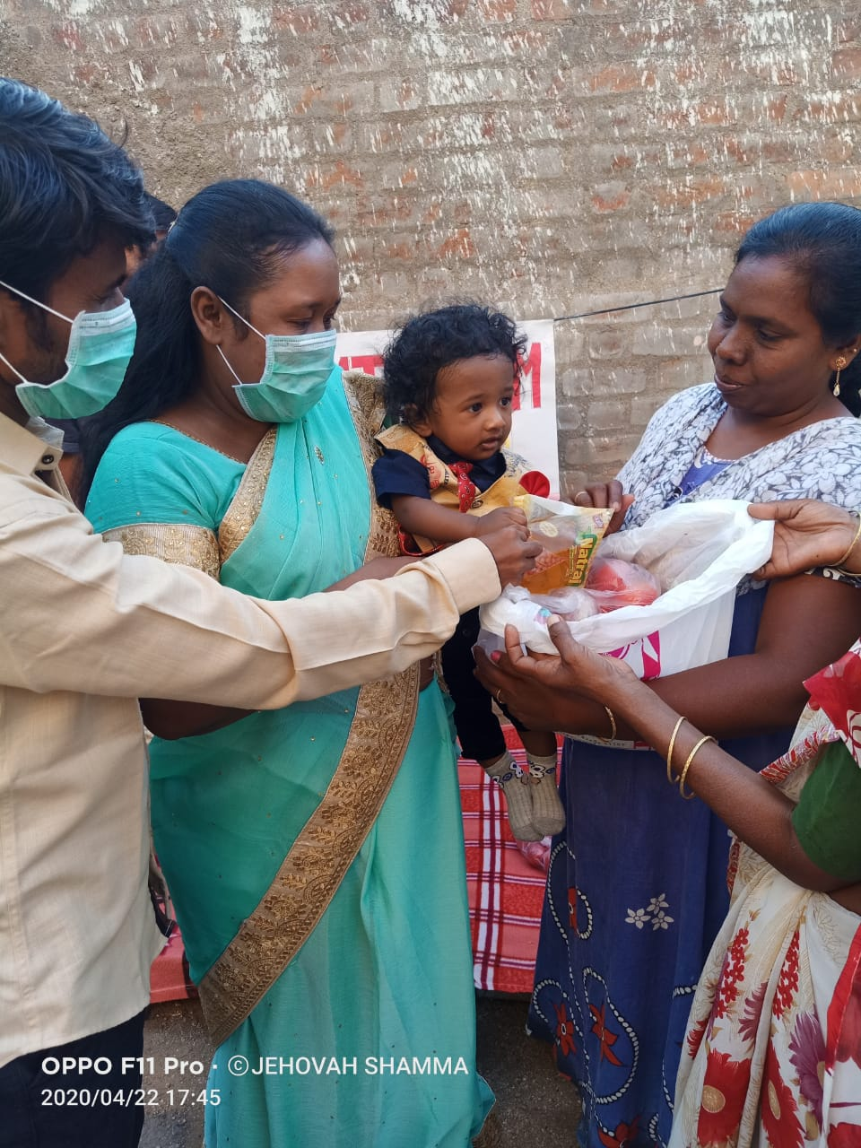
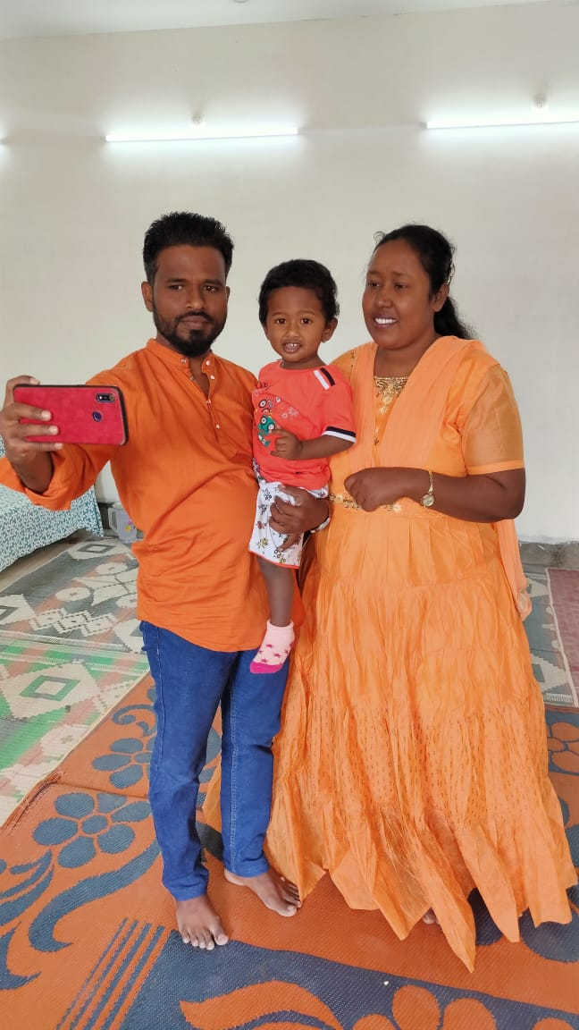
WELCOME TO INDIA
Pastor Ponnala Prabhudas and His Wife Angel & Son Augustine
Our Location: City Name: Asifabad
District ,Komarambheem – 504295. Telangana State, India.
Doing ministry among the unreached unengaged people groups of India

Slide 2
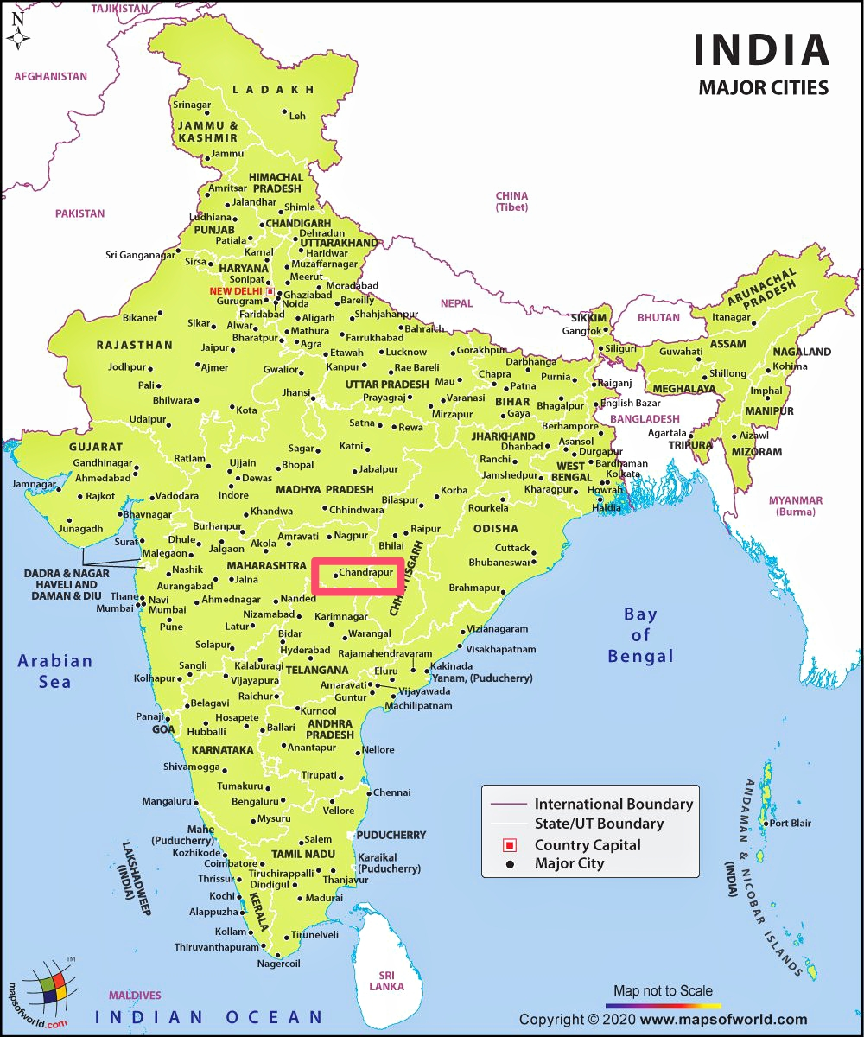
.
Country: India, South Asia
Number of People Groups: 2,373 People Groups Unreached: 2,135 (90.0%) Progress Level Total Population: 1,400,230,000 Population in Unreached: 1,332,045,000 (95.1%) Largest Religion: Hinduism 80.1% % Christian Adherent * 2.32% % Evangelical : Unknown Evangelical Annual Growth Rate 3.9%(Global Rate = 2.6%)

Slide 3
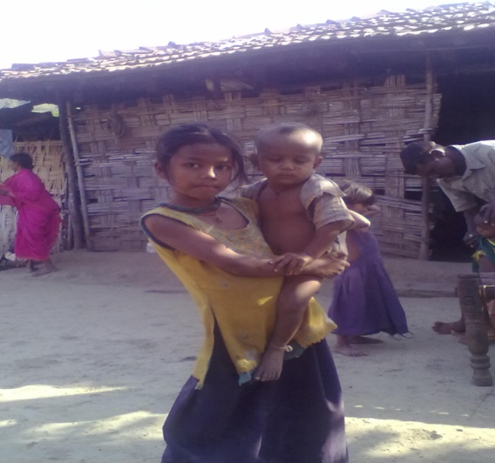
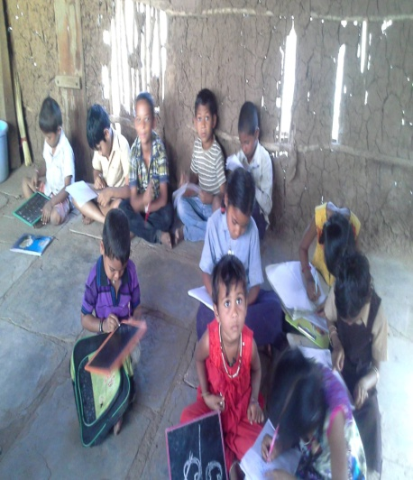
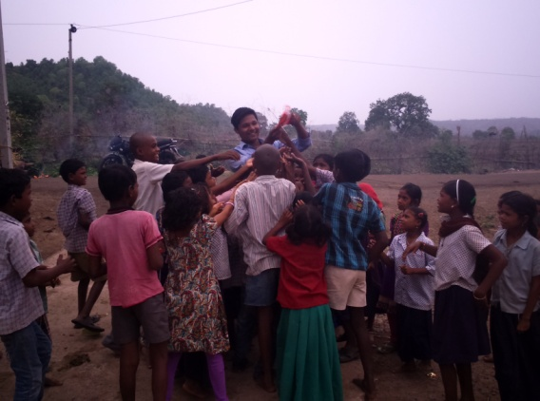
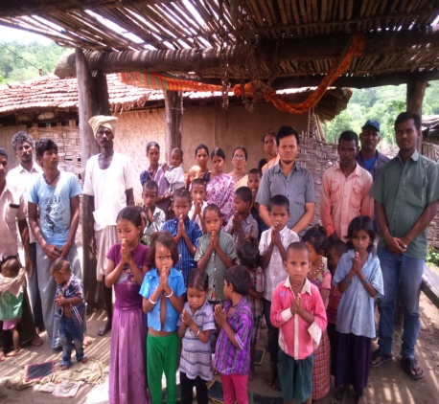
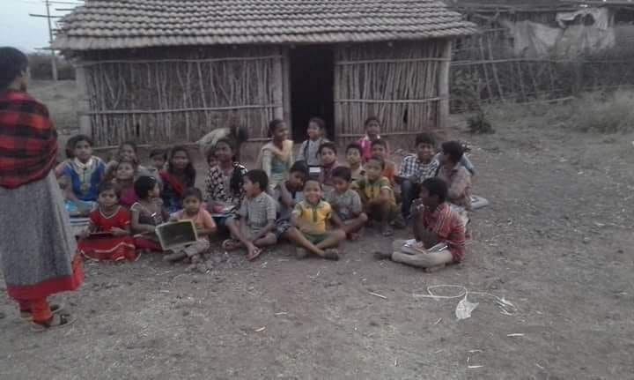
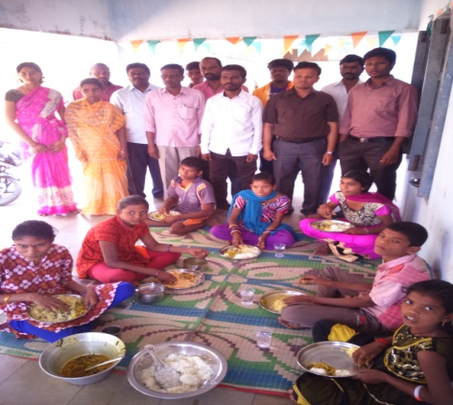
Unreached groups of Telangana & Maharashtra: Children life styles
There are as many as 597,483 inhabited villages in India and among them 82,149 villages have a population size of less than 200 . Nearly half of the rural population of India is residing in 115,029 villages with population more than 2,000 but less than 10,000.
Tribal girls are not allowed to go to school and getting married in age of 12 or 13
Boys are sold by parents to the land lords as a slaves for life time
Tribal kids are offered as human sacrifice to the idols by their own parents
alcohol & smoking habit is from the childhood they make it in their homes
hunting & forming is trained by childhood
Which craft is one of the famous practice to earning from childhood
Begging & stealing is thought by the parents

Slide 4
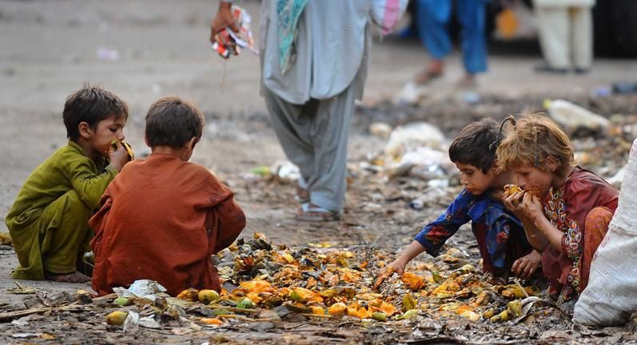
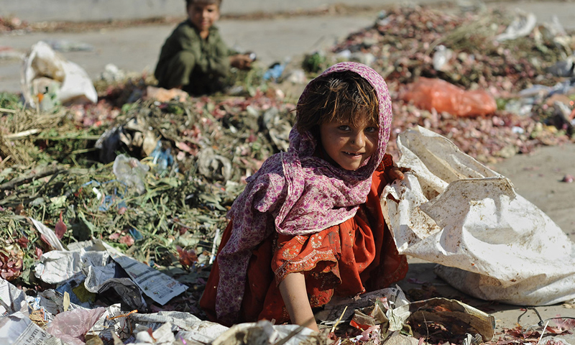
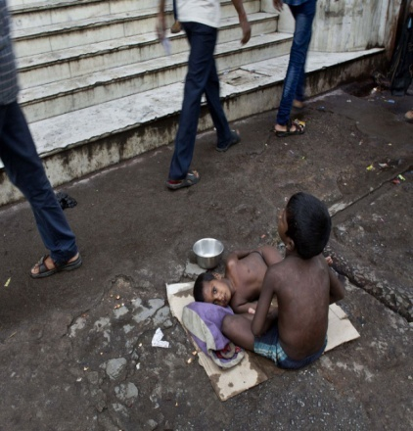
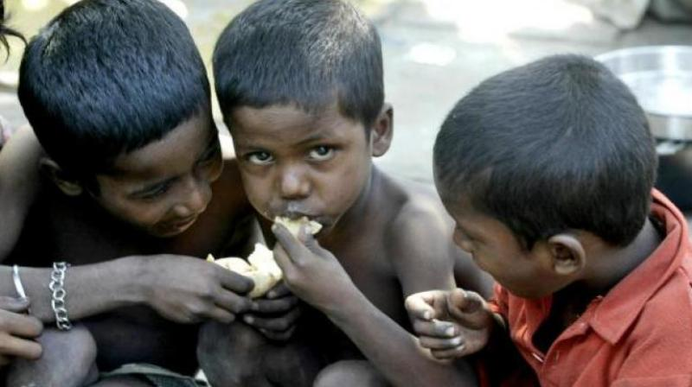
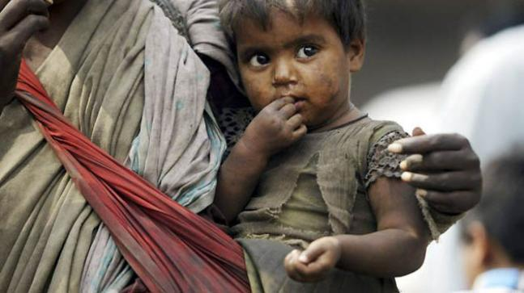
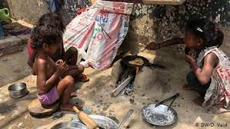
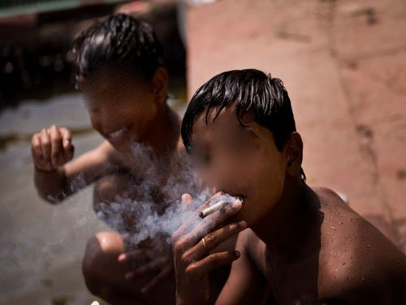
India consists of 30.3 per cent of extremely poor children living across the world. Close to 9.97 crore children in India live in poverty-stricken conditions
causes of child poverty in India?
Education and illiteracy – Lack of education and growing illiteracy is majorly responsible for poverty in India.
two million fewer children are out-of-school
Poverty has negative impacts on children's health, social, emotional and cognitive development, behavior and educational outcomes.
Children born into poverty are more likely to experience a wide range of health problems, including poor nutrition, chronic disease and mental health problems.

Slide 5
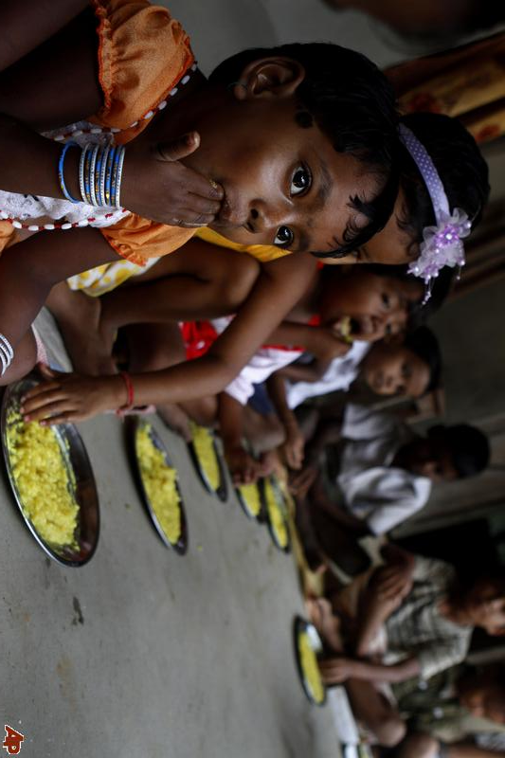
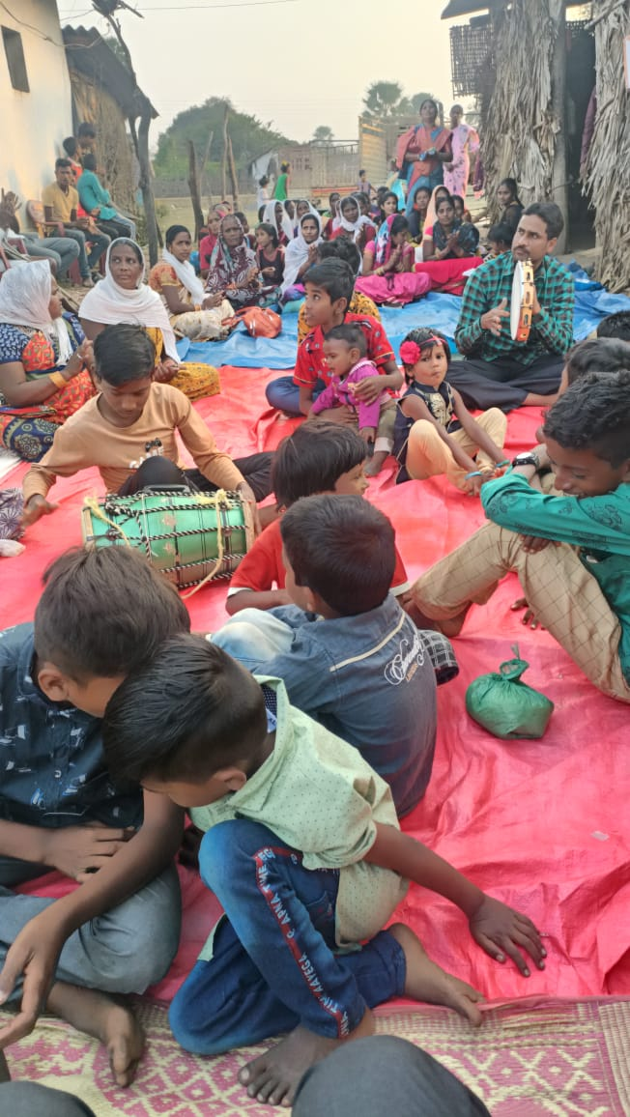
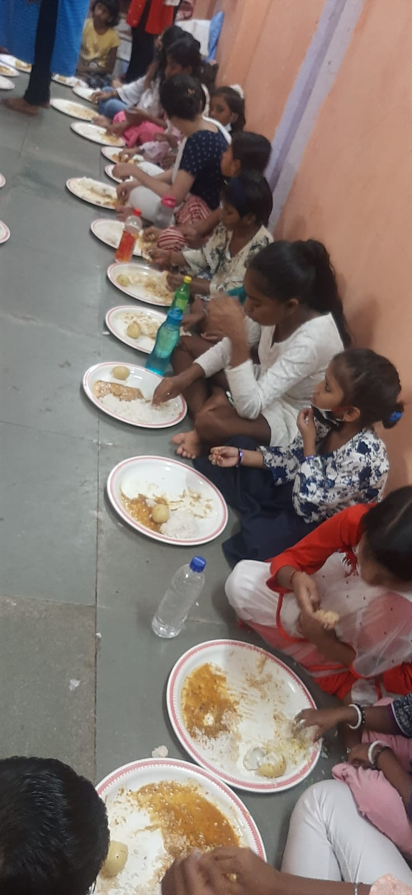
How can we stop child poverty? This is what might work to reduce poverty.
Prayer
Parental Relationships.
Better Parenting.
Develop early years (pre-school)
education.
Better primary and secondary education.
Child care centers
Orphanages
Leadership & Commitment.

Slide 6
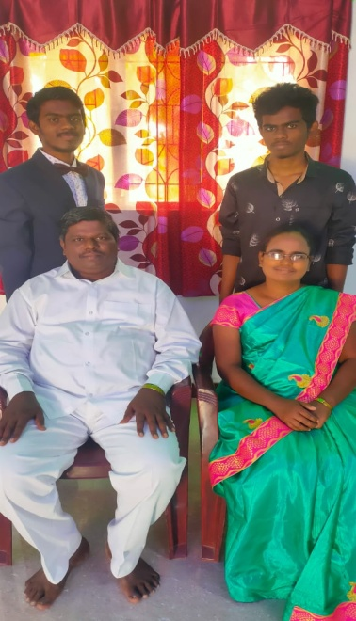
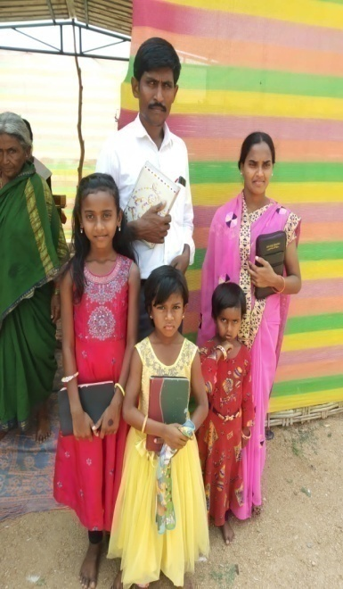
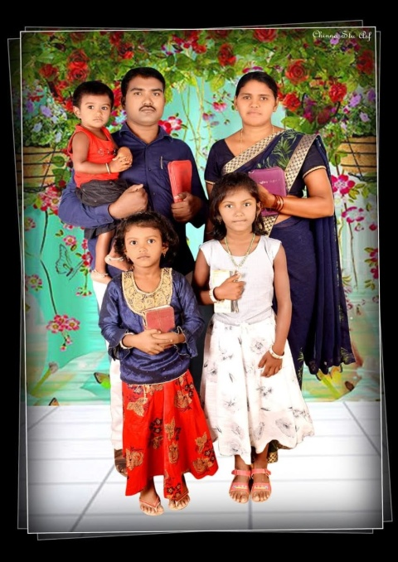
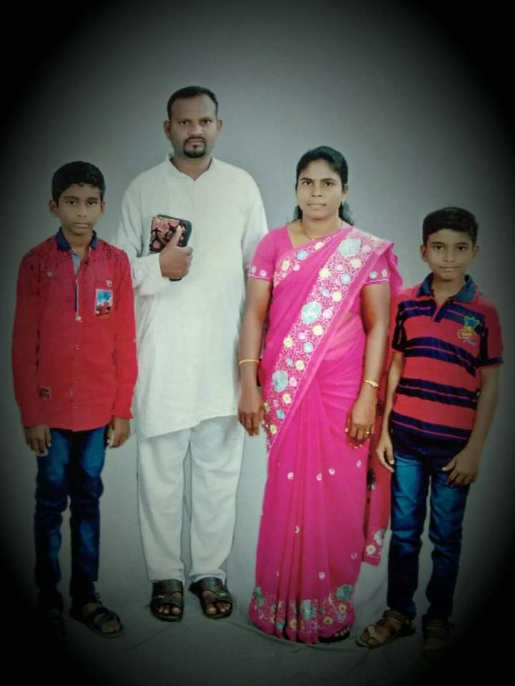
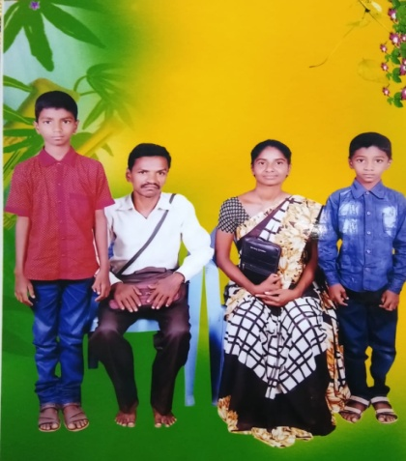
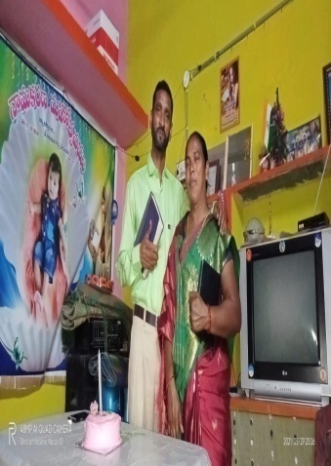
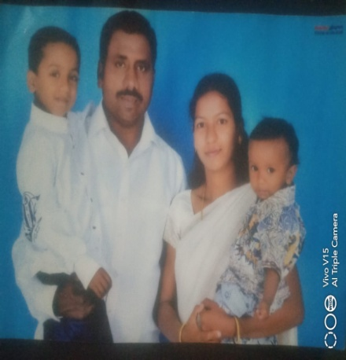
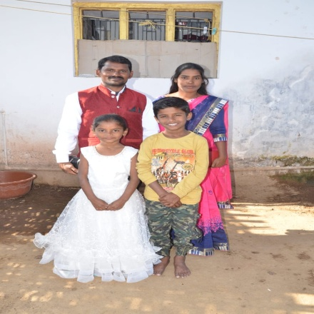
Our Team of Missionaries working with us in reaching the unreached
unengaged people Groups of India
Joseph Timothy Sunil Andreah Rajesh Paul
Sathyapal Tirupathi Shadrak Raju Santhosh

Slide 7
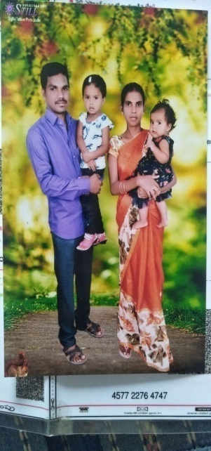
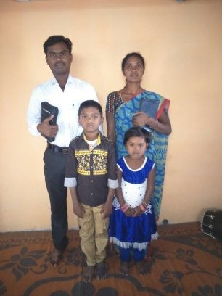
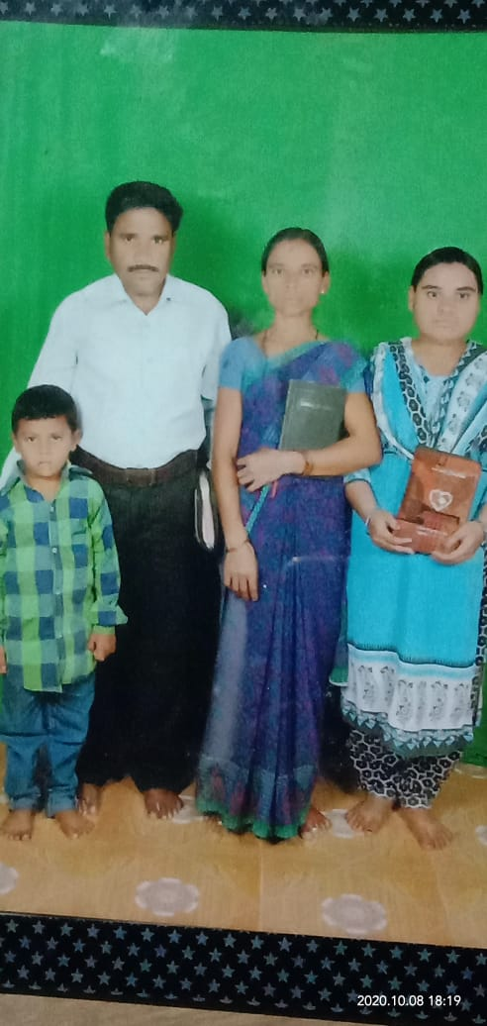
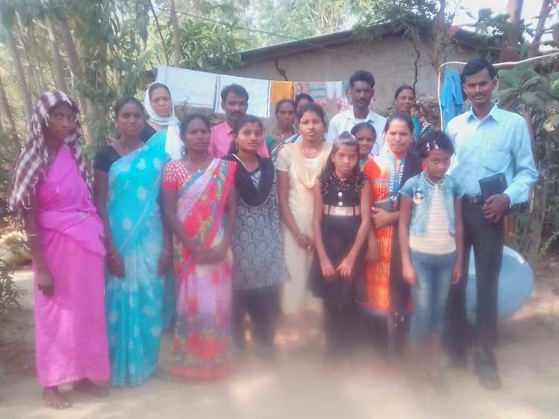
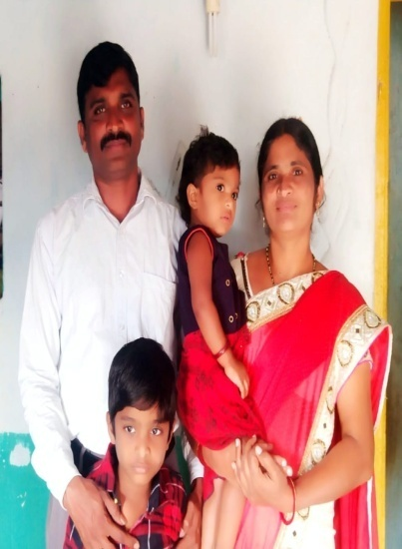
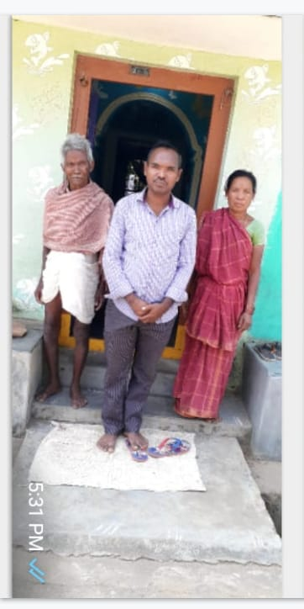
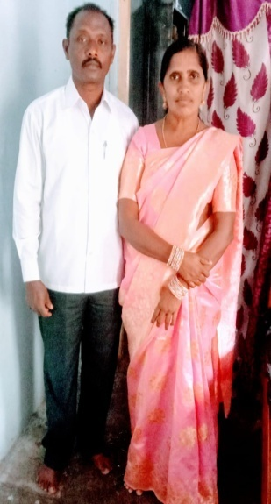
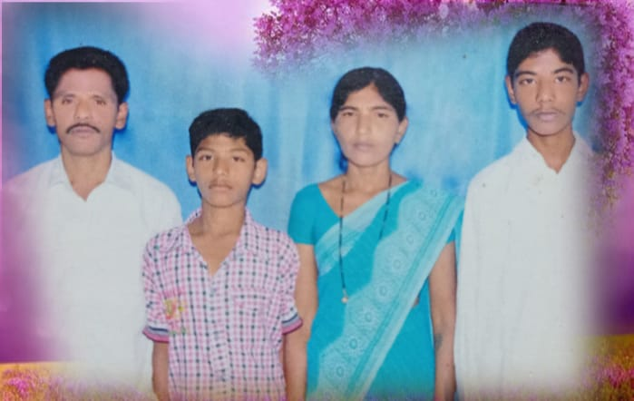
Joseph Naresh Santhosh Raesh Issac Newton
Rathnam Prabhudev Vilas Mathai Venkati

Slide 8
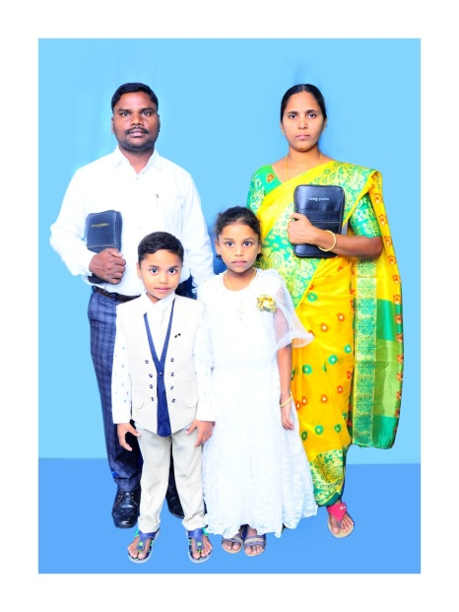
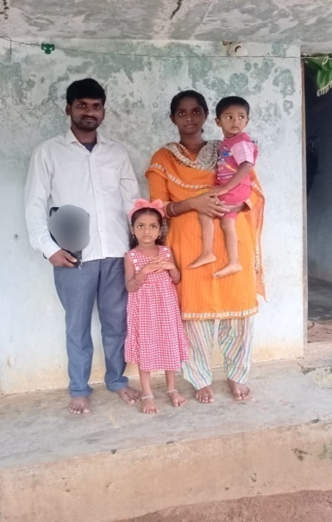
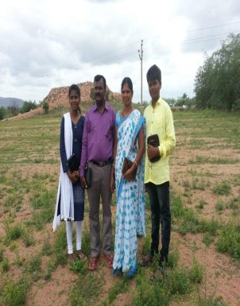
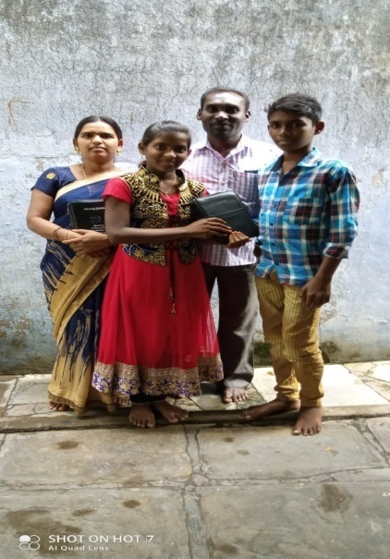
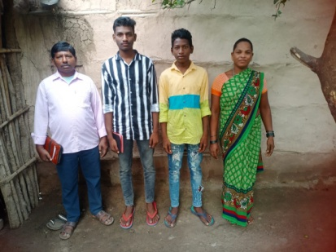
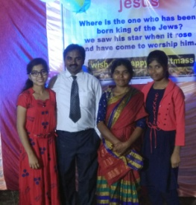
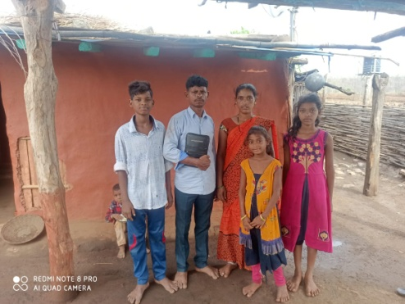
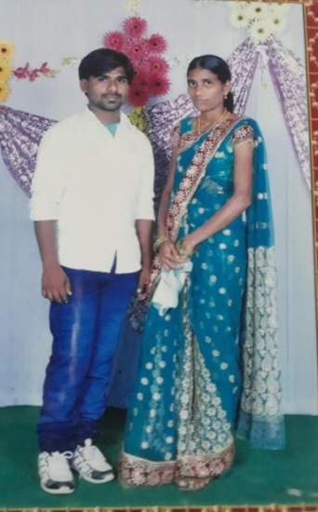
Suraj Prabu Ramesh Bhaskar Salomon
Bheemrao Jeremiah Anandrao Prabhakar Madhukar

Slide 9
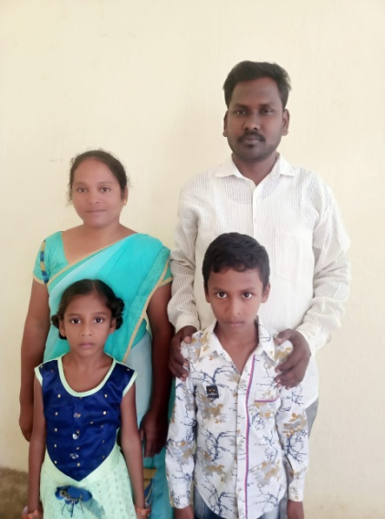
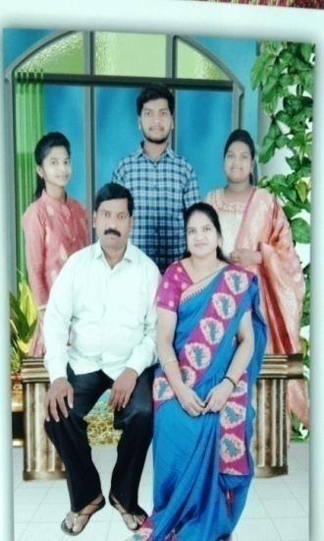
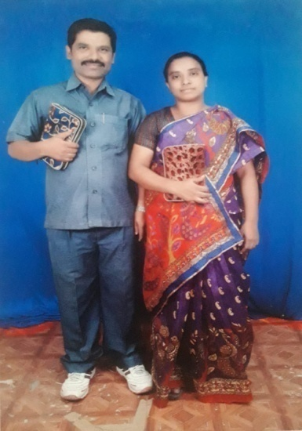
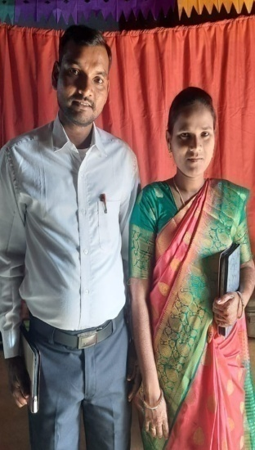
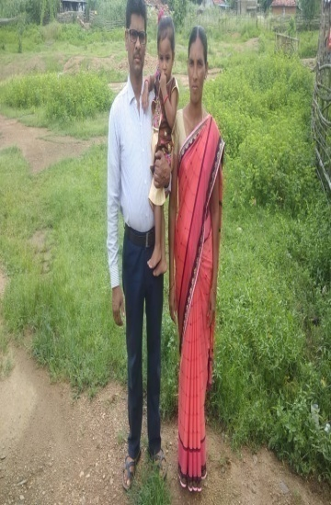
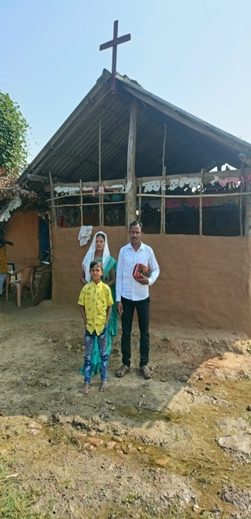
Suraj Jayaraju Yeliya Ananth Zachariah
Korkaiah Sudhakar Ramakrishna Yesdas Ramesh

Slide 10
Orphanage & Street kids ministry

Slide 12
Evangelism &Discipleship Training

Slide 13
Outreach Programs

Slide 14
Our MISSION Towards Community Development
Literacy: the percentage of illiteracy in India is alarming. Every five persons among ten in India are illiterate. The condition in villages is worse than in cities
Basic Hygiene: Sanitation is yet another problem in India. There are about 700 million people who have no access to toilets at home.
Nutrition & Healthcare: 50% of all villagers have no access to healthcare providers; 10% of babies die within a year of their birth; lack of nutrition causes stunted growth in 50% of all the babies; and 33% people in India have no access to toilets.
Food Safety: A third of the world’s poor live in India, and 37% of the total population in India lives below the international poverty line. 42% of children under five years of age are underweight.
Women’s safety: Both men and women enjoy equal opportunities, but as far as freedom and safety of women is concerned, India lags behind. Issues like domestic violence, rape cases, portrayal of women in media, etc., must be tackled immediately.

Slide 15
Challenges & Prayer needs
We are facing daily persecution for the sake of the gospel every day some where some missionaries are beaten and killed in forest villages
Through community development activates its easy to reach people by helping the helpless tribal groups such as by starting sewing machine training centers and self help programs
There are need of more child care homes and orphanages
There is need of English medium school to be started
There is need of more workers in His vineyard to extend the kingdom of God among the unreached communities
There are villages suffering without drinking water
Please pry for provision to help the helpless through drinking water and food distribution
There is need of financial provision to help the pastors families those who are doing ministry in villages
There is need of land and church buildings to be constructed
Expecting your prayers and contributions towards the cause of social transformation through the child care centers & education

Slide 16
For more details Please contact us
Pastor Ponnala Prabhudas & Angel Rani.
1-62, Village Bambara, Asifabad-504295.
Telangana State, India
Mobile & WhatsApp : +919440953407 (Ponnala)
Mobile & WhatsApp : +91 8555003600 (Angel Rani)
Email : prabhuponnala@gmail.com

